Slide 1


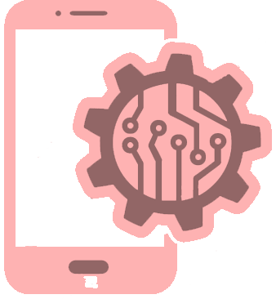
P P Savani University
School of Engineering
Course Name: Software Engineering
Course Code: SSCS3010
SECTION I
Unit-2
Software Process Models

Slide 2
Process Model – Introduction & Use
The process model is the abstract representation of process.
Also known as Software development life cycle (SDLC) or Application development life cycle Models
Process models prescribe a distinct set of activities, actions, tasks and milestones (deliverables) required to engineer high quality software.
Process models are not perfect, but provide roadmap for software engineering work.
Software models provide stability, control and organization to a process that if not managed can easily get out of control.
Software process models are adapted (adjusted) to meet the needs of software engineers and managers for a specific project.

Slide 3
SDLC Phases
Communication
SDLC
Deployment
Planning
Software
Development
Life
Cycle
Construction
Modeling

Slide 4
Types of Process Models
Waterfall Model (Linear Sequential Model)
Incremental Process Model
Prototyping Model
The Spiral Model
Rapid Application Development Model
Agile Model

Slide 5
The Waterfall Model
Communication
  Project initiation, requirements gathering
Planning
  Estimating, scheduling, tracking
Modeling
  Analysis, design
Construction
  Code, test
Deployment
  Delivery, support, feedback

Slide 6
The Waterfall Model cont.
When requirements for a problems are well understood then this model is used in which work flow from communication to deployment is linear
This Model also called as the Classic life cycle or linear sequential model.
When to use ?
  Requirements are very well known, clear and fixed
  Product definition is stable
  Technology is understood
  There are no ambiguous (unclear) requirements
  Ample (sufficient) resources with required expertise are available freely
  The project is short

Slide 7
The Waterfall Model cont.
Advantages
  Simple to implement and manage
Drawbacks
  Unable to accommodate changes at later stages, that is required in most of the cases.
  Working version is not available during development. Which can lead the development with major mistakes.
  Deadlock can occur due to delay in any step.
  Not suitable for large projects.

Slide 8
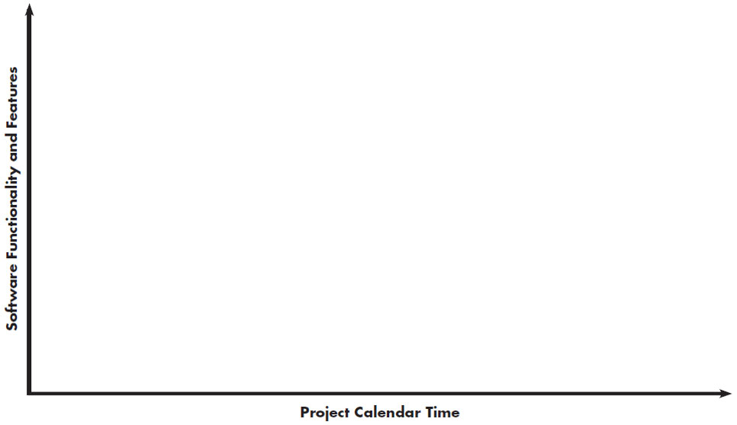
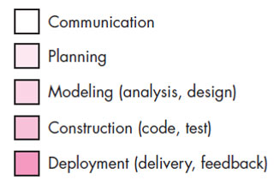
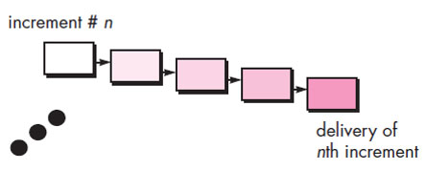
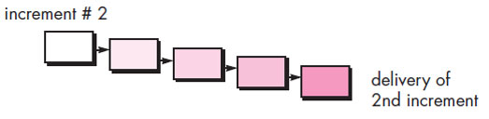
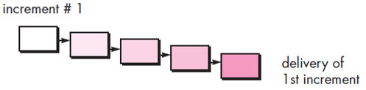
Incremental Process Model

Slide 9
Incremental Process Model cont.
The incremental model combines elements of linear and parallel process flows.
This model applies linear sequence in a iterative manner.
Initially core working product is delivered.
Each linear sequence produces deliverable “increments” of the software.
For example, word-processing software developed using the incremental model
  It might deliver basic file management, editing and document production functions in the first increment
  more sophisticated editing in the second increment;
  spelling and grammar checking in the third increment; and
  advanced page layout capability in the fourth increment.

Slide 10
Incremental Process Model cont.
When to Use ?
  When the requirements of the complete system are clearly defined and understood but staffing is unavailable for a complete implementation by the business deadline.
Advantages
  Generates working software quickly and early during the software life cycle.
  It is easier to test and debug during a smaller iteration.
  Customer can respond to each built.
  Lowers initial delivery cost.
  Easier to manage risk because risky pieces are identified and handled during iteration.

Slide 11
Evolutionary Process Models
When a set of core product or system requirements is well understood but the details of product or system extensions have yet to be defined.
In this situation there is a need of process model which specially designed to accommodate product that evolve with time.
Evolutionary Process Models are specially meant for that which produce an increasingly more complete version of the software with each iteration.
Evolutionary Models are iterative.
Evolutionary models are
  Prototyping Model
  Spiral Model
  Concurrent Development Model

Slide 12
Prototyping model
Prototyping model is appropriate when
  Customers have general objectives of software but do not have detailed requirements for functions & features.
  Developers are not sure about efficiency of an algorithm & technical feasibilities.
It serves as a mechanism for identifying software requirements.
Prototype can be serve as “the first system”.
Both stakeholders and software engineers like prototyping model
  Users get feel for the actual system
  Developers get to build something immediately

Slide 13
Prototyping model cont.
Deployment & Feedback
Communication
Construction of Prototype
Quick Plan
Modeling Quick Design

Slide 14
Prototyping model cont.
It works as follow
  Communicate with stockholders & define objective of Software
  Identify requirements & design quick plan
  Model a quick design (focuses on visible part of software)
  Construct Prototype & deploy
  Stakeholders evaluate this prototype and provides feedback
  Iteration occurs and prototype is tuned based on feedback
Problem Areas
  Customer demand that “a few fixes” be applied to make the prototype a working product, due to that software quality suffers as a result
  Developer often makes implementation in order to get a prototype working quickly; without considering other factors in mind like OS, Programming language, etc.

Slide 15
Prototyping model cont.
Advantages
  Users are actively involved in the development
  Since in this methodology a working model of the system is provided, the users get a better understanding of the system being developed
  Errors can be detected much earlier

Slide 16
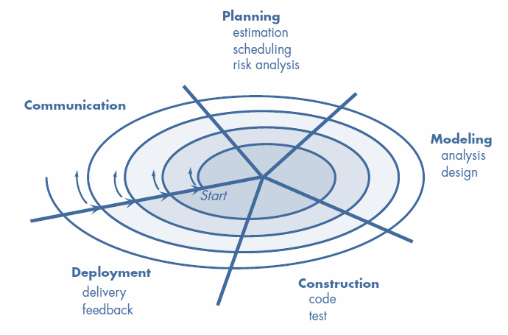
The Spiral Model

Slide 17
The Spiral Model cont.
The Spiral model is an evolutionary process model that couples iterative nature of prototyping with the controlled and systematic aspects of waterfall model
It provides the potential for rapid development.
Software is developed in a series of evolutionary releases.
Early iteration release might be prototype but later iterations provides more complete version of software.
It is divided into framework activities (C,P,M,C,D). Each activity represent one segment of the spiral
Each pass through the planning region results in adjustments to
  the project plan
  Cost & schedule based on feedback

Slide 18
The Spiral Model cont.
When to use Spiral Model?
  For development of large scale / high-risk projects.
  When costs and risk evaluation is important.
  Users are unsure of their needs.
  Requirements are complex.
  New product line.
  Significant (considerable) changes are expected.
Advantages
  High amount of risk analysis hence, avoidance of Risk is enhanced.
  Strong approval and documentation control.
  Additional functionality can be added at a later date.
  Software is produced early in the Software Life Cycle.

Slide 19
The Spiral Model cont.
Disadvantages
  Can be a costly model to use.
  Risk analysis requires highly specific expertise.
  Project’s success is highly dependent on the risk analysis phase.
  Doesn’t work well for smaller projects.

